Slide 1
Online Retail Segmentation Project Report
Project Title: Online Retail Segmentation
Submitted By: Sehrish Fatima
Roll No: GIL-DSAI-033
Instructor: Dr. Muhammad Bilal
Project Overview:
The objective of this project is to analyze customer data from an online retail dataset to segment customers and understand their purchasing behavior.

Slide 2
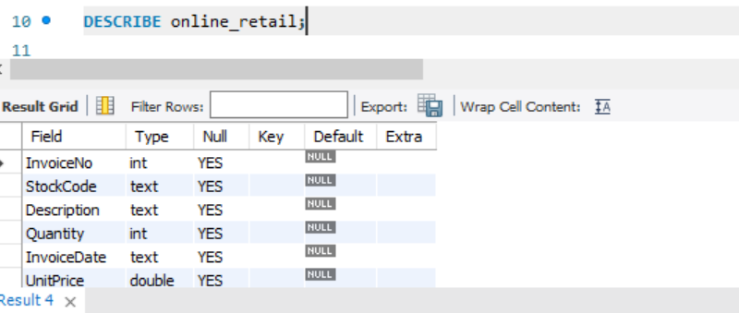
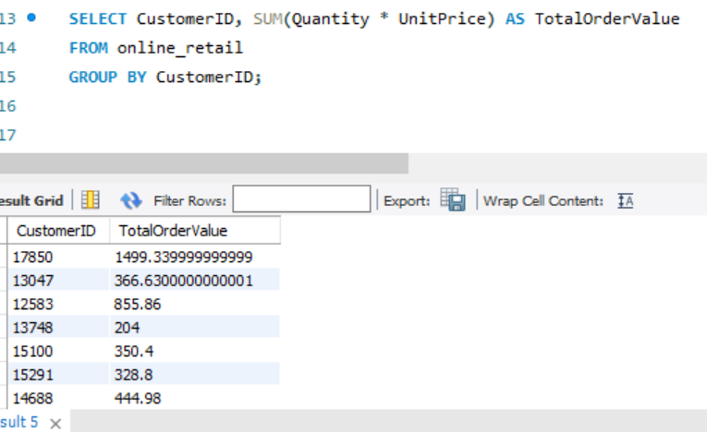
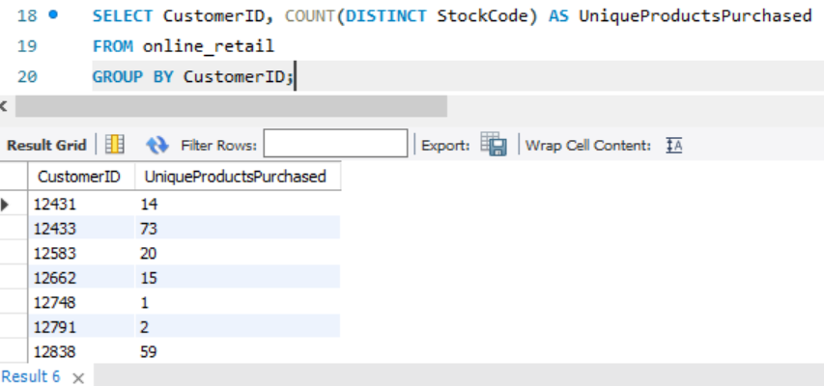
Query Analysis:
BEGINNER QUERIES:
1) Metadata Definition:
Provides the structure of the table, including column names,
data types, and constraints, essential for understanding the dataset.
2) Distribution of Order Values Across All Customers:
Calculates the total spending per customer, identifying high-value
customers.
3) Unique Products Purchased by Each Customer:
Counts the number of unique products purchased by each customer,
showing product variety in purchases.

Slide 3
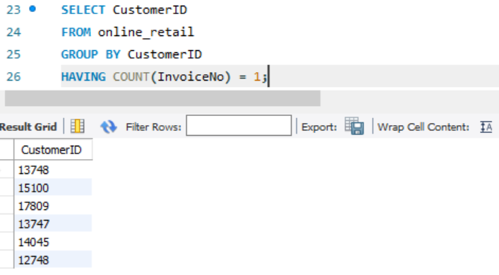
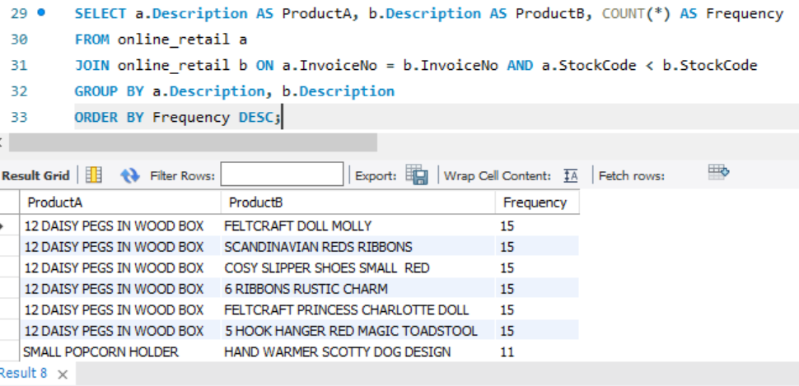
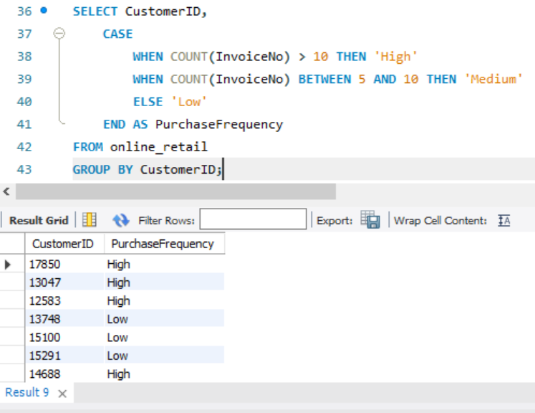
4) Customers with Only One Purchase: Identifies customers with only one purchase, highlighting potential areas for customer retention. 5) Products Most Commonly Purchased Together: Finds pairs of products frequently bought together, useful for cross-selling strategies. ADVANCED QUERIES: 1) Customer Segmentation by Purchase Frequency: Segments customers based on their purchase frequency into 'High', 'Medium', or 'Low'.

Slide 4
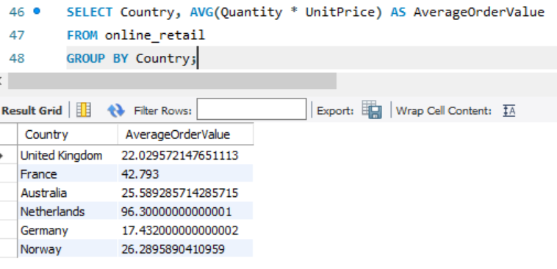
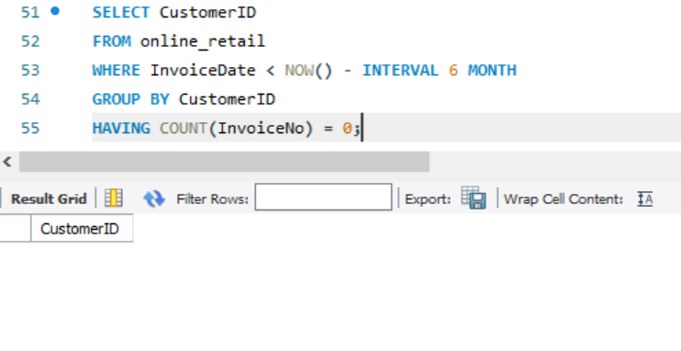
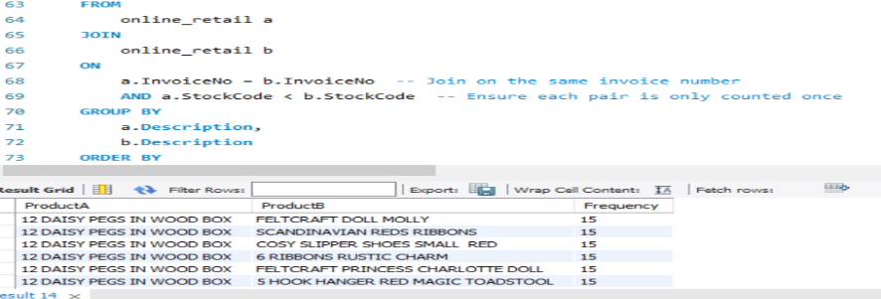
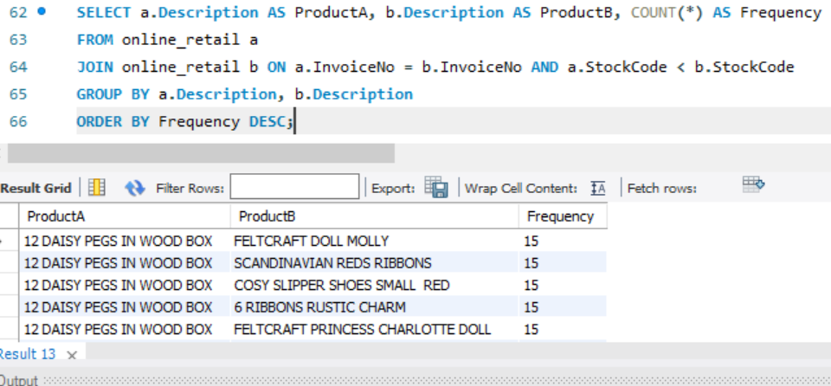
2) Average Order Value by Country: Calculates the average order value for each country, helping to identify regions with high spending. 3) Customer Churn Analysis: Identifies customers who have not made a purchase in the last 6 months, indicating potential churn. 4) Product Affinity Analysis: Identifies product pairs that are commonly purchased together, assisting in cross-selling and product placement strategies. 5) Time-Based Analysis: This query explores trends in customer behavior over time by summarizing total sales per month and the result will show total sales for each month,

Slide 5
Conclusion: The analysis provided insights into customer spending, product affinities, and purchase patterns. Key findings include high-value customers, frequent product pairs, and customer segments based on purchase frequency.

